Slide 1
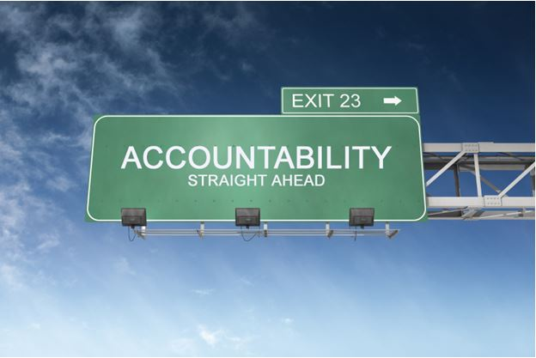
Importance of Accountability in School Counseling
Samantha Fitzjarrald, Ball State University

Slide 2
What is Accountability?
Accountability is a major part of the ASCA National Model along with foundation, delivery, and management (ASCA, 2012).
Includes data analysis, program results, evaluation & improvement
“Accountability requires systematically collecting, analyzing, and using critical data elements to understand the current achievement story for students, and to begin to strategize, impact, and document how the school counseling program contributes toward supporting student success” (Stone & Dahir, 2003, p. 214).
Notes:
Briefly summarize the ASCA National Model and talk about how more schools are using it for a baseline of what to do.
Talk about my longterm goal is to align with the ASCA National Model and to combine them with the Indiana standards for students.

Slide 3
Accountability within an educational system typically refers to whether or not a person or program is making a positive impact in areas such as test scores, attendance, retention, dropout rates, grades, and success in more difficult academic curriculums.
Stone & Dahir, 2003
Notes:
Emphasize that teachers are expected to live up to these expectations. School counselors should be thriving to do the same.
Emphasized how each program can benefit certain areas of this or even multiple areas at once

Slide 4
School counselors need to hold themselves accountable to the same standards that other educators do.
School counselors need to show that their programs are making a difference in their students lives (Gysbers, 2004).
This means evaluating the program as a whole and evaluating the different programs within the curriculum.
According to Astramovich and Coker (2007), program evaluation happens before accountability because program evaluation helps counselors plan, implement, and refine their counseling practices. Accountability is a way to provide information to the different stakeholders within the school and community to demonstrate the effectiveness of the different counseling services
Notes:
Discuss the changing trends in accountability and how school counselors are starting to be evaluated similarly to teachers, especially in Indiana. Talk about need for job security by proving school counselor’s worth.

Slide 5
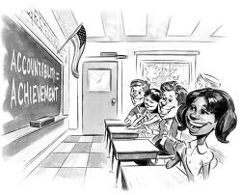
How Will This Help Our School?
Becoming accountable in one’s school means becoming a powerful leader in the school and makes it easier for a school counselor to meet the needs of the students (Stone & Dahir, 2003).
Changes the focus to be on equity and closing the achievement gap (Holcomb-McCoy, 2007).
School counselors can collect achievement, attainment/access, or school climate data to be used to improve the school.
Notes:
Talk about how we can use the school profile’s data sheet on the IDOE to improve areas of concern which will end up raising the school’s overall grade.
Discuss the difference between equity and equality and how school counselors should be equity-focused.

Slide 6
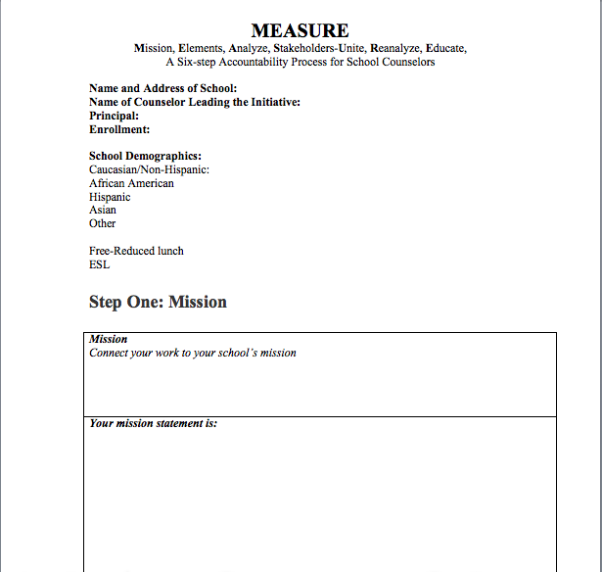
Ways To Measure Accountability: MEASURE
Six Steps to Improving Students’ Success
Measure stands for Mission, Elements, Analyze, Stakeholders-Unite, Results, Educate, and systematic change (Stone & Dahir, 2011).
This system looks at each individual program school counselors provide to determine if they are actually helping students. It also helps include people within the school and community in improving the success of the students.
Notes:
Pass out MEASURE worksheet that shows how to write out each area.
Give an example of how to actually do it.
Explain each step thoroughly.
Discuss wanting to actually use this for each individual program to prove the program’s importance

Slide 7
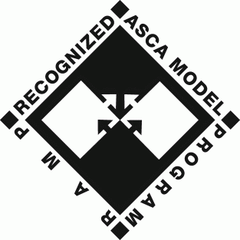
ASCA’s RAMP
This is ASCA’s system for determining the effectiveness of school counseling programs.
RAMP helps school counselors evaluate their program and identify areas in need of improvement (ASCA, 2012).
Programs are evaluated on their vision statement, mission statement, school counseling program goals, ASCA Student Standards (competencies and indicators), annual agreement, advisory council, calendars, school counseling core curriculum action plan and lesson plans, school counseling core curriculum results report, small-group responsive services, closing-the-gap results report, and the program evaluation reflection (ASCA, 2012).
If programs score high enough, they will become a RAMP certified program (ASCA, 2012).
Notes:
Ramp stands for Recognized ASCA Model Program

Slide 8
Indiana Gold Star
This is Indiana’s standards for determining if a school counseling program is effective.
The goal of the Gold Star School Counseling Initiative is to answer three questions: what do students gain from Indiana school counseling programs, what are the components of a sound school counseling program, and what skills and knowledge do school counselors possess?
Nine standards including program foundation, data-based accountability, student guidance, student counseling, student advocacy, program management, professionalism, professional resources, and a school counseling improvement plan (ASAI, 2013)
Standards match up with the IDOE’s student standards
Notes:
Gold Star is recognized by the Indiana School Counselor Association and created by the American Student Achievement Institute. Talk about how this is the model you most want to align yourself with since it matches the student standards setup by the IDOE.

Slide 9
Why Is Looking At Previous Research Important?
Dimmitt, Carey, and Hatch (2007), “school counselors are much more likely to be able to document impact when they are using interventions and practices that have already been found to be effective” (p. 50).
Looking at previous research helps a school counselor determine if interventions actually work with students, or if they are wasting their time using certain interventions. This means school counselors can find ways to make better use of their time and help improve the overall goals of the school.
Notes:
Discuss how we are going to look at some examples of successful programs and the research that shows their effectiveness

Slide 10
Examples: Classroom Climate
School climate is extremely important within a school and within each individual classroom.
Sink (2005 & 2007) examined the My Class Inventory-Short Form (MCI-SF) that many school counselors used to evaluate classroom climate to determine if it is actually effective.
Sink (2005) looked at the effectiveness of the scale given to the students by examining 2,835 students from the fourth, fifth, and sixth grades in twenty different schools in Washington.
Results were mixed because 4 scales were reliable (Satisfaction, Cohesion, Competitiveness, and Friction) but the Difficulty scale was not reliable. Therefore, school counselors learned to only use the 18-items from the 4 reliable scales.
School counselors would not have learned this without using evidence-based practices.
Notes:
Explain the importance of classroom climate and making the students feel safe/comfortable

Slide 11
Classroom Climate
Sink (2007) examined if the teacher’s version of the MCI-SF was effective.
The study analyzed information from 371 elementary teachers at 22 participating elementary schools using the MCI-SF for Teachers.
This is different from the MCI-SF because it is a 30-item measure given directly to the teachers.
Sink and Spencer found that the measure needed some revision, and cut it down to 24-items.
These items matched up with the student version so one could compare how the teachers versus the students felt about their classroom.
After the revisions, the measure was reliable and would be an effective tool for school counselors to use to assess classroom climate in an elementary school.
Notes:
Expand on using this survey shortly into the school year and towards the middle to see how students/teachers feel about the environment and to identify any students who may need extra help.

Slide 12
Examples: Social Skills Training
In elementary schools, guidance presentations often revolve around social skills so it is important to look at the research of what works and what does not work.
Bostick and Anderson (2009) examined the effectiveness of a small-group counseling program working on social skills with third graders. Forty-nine third graders were chosen to participate in a ten-week group counseling program called Social Skills Group Intervention (S.S.GRIN).
Assessed students on loneliness and social anxiety using a 16-item Loneliness and Social Dissatisfaction Questionnaire and five items from the 18-item Social Anxiety Scale for Children-Revised
The results of this study showed that students who expressed loneliness and worry over friendships before the start of the group were less worried when the group ended. The school counselor also sent out teacher and parent evaluations to see if the child was more cooperative, had more confidence, and if the child displayed better communication skills, with a majority of positive responses
Notes:
Discuss the importance of expanding classroom guidance into small groups to further assist students who need it. (CLOSING THE ACHIEVEMENT GAP)
Each school does something with social skills, why not have one that is proven to be effective?

Slide 13
SO WHAT IS MY GOAL FROM ALL OF THIS?
I want to create a program within our schools using program evaluations to make myself more accountable. I will do this by using previous research and evidence-based practices. This way, our program will be equity-focused and will make sure that the needs of all students are being met. This not only improves my success, but the entire school’s success.

Slide 14
Any Questions?

Slide 15
References
American School Counselor Association (2008). The ASCA national model: Learn more about ramp. Retrieved from http://www.ascanationalmodel.org/learn-about-ramp
American School Counselor Association (2012). The ASCA National Model: A framework for school counseling programs (3rd. ed.). Alexandria, VA: Author.
American Student Achievement Institute (ASAI) (2013). Indiana Gold Star School Counseling. Retrieved from http://www.asainstitute.org/schoolcounseling/standards.html
Astramovich, R. L. & Coker, J. K. (2007). The accountability bridge model for counselors. Journal of Counseling and Development, 85, 162-172.
Bostick, D. & Anderson, R. (2009). Evaluating a small-group counseling program-A model for program planning and improvement in the elementary setting. Professional School Counseling, 12, 428-433.
Dimmitt, C., Carey, J., & Hatch, T. (2007). Evidence-Based school counseling: Making a difference with data-driven practices. Thousand Oaks, CA: Corwin Press.

Slide 16
References Continued..
Gysbers, N. C. (2004). Comprehensive guidance and counseling programs: The evolution of accountability. Professional School Counseling, 8, 1-28.
Holcomb-McCoy, C. (2007). School counseling to close the achievement gap: A social justice framework for success. Thousand Oaks, CA: Corwin Press.
Sink, C. A. & Spencer, L. R. (2005). My class inventory-short form as an accountability tool for elementary school counselors to measure classroom climate. Professional School Counseling, 9, 37-48.
Sink, C. A. & Spencer, L. R. (2007). Teacher version of the my class inventory-short form: An accountability tool for elementary school counselors. Professional School Counseling, 11, 129-139.
Stone, C. B. & Dahir, C. A. (2003). Accountability: A M.E.A.S.U.R.E. of the impact school counselors have on student achievement. Professional School Counseling, 6, 214-222.
Stone, C. B. & Dahir, C. A. (2011). School counselor accountability: A MEASURE of student success (3rd . ed.). Upper Saddle River, NJ. Pearson.

