Slide 1
Skillstreaming Team:
Miss Wilson, Special Services Intern
Miss Fitzjarrald, School Counseling Intern
Mrs. Hammons, School Counseling Intern

Slide 2
What is Skillstreaming?
Social Skills

Slide 3
What is Skillstreaming?
Social Skills
Like Academic Skills

Slide 4
What is Skillstreaming?
Social Skills
Like Academic Skills
Skill for today - Dealing with Group Pressure

Slide 5
Groups are Powerful
Groups of people have done terrible and wonderful things…

Slide 6
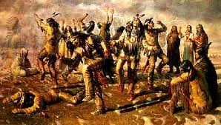
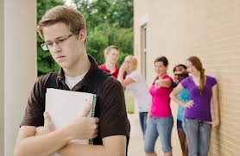
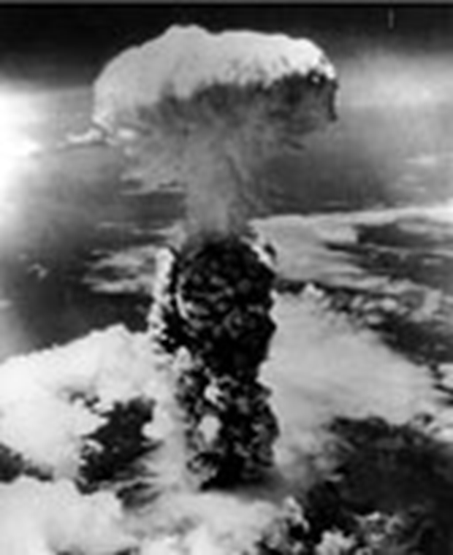


Slide 7
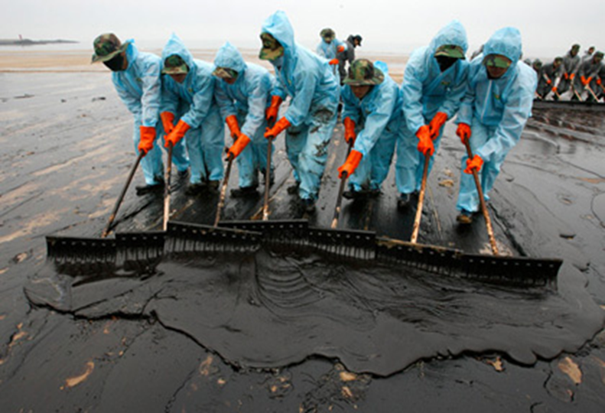
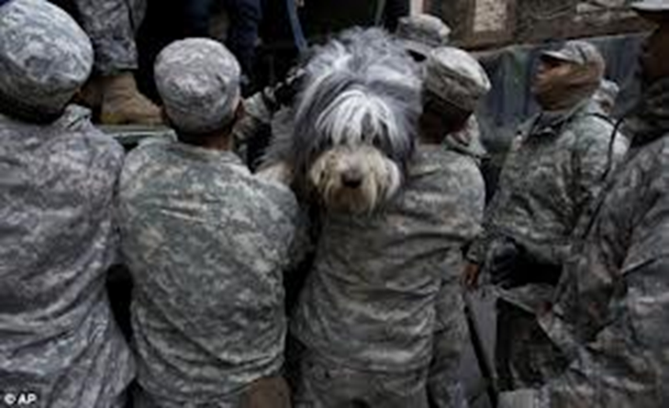
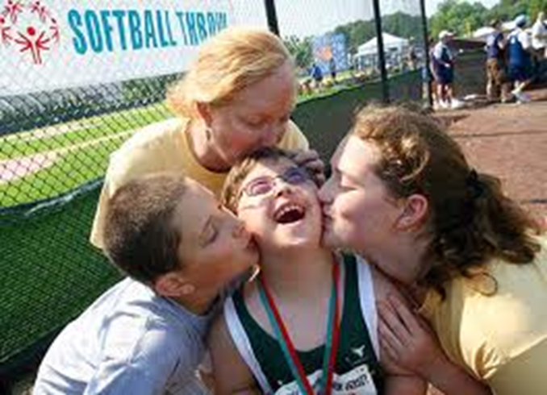
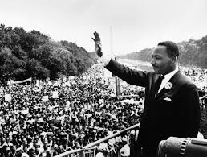
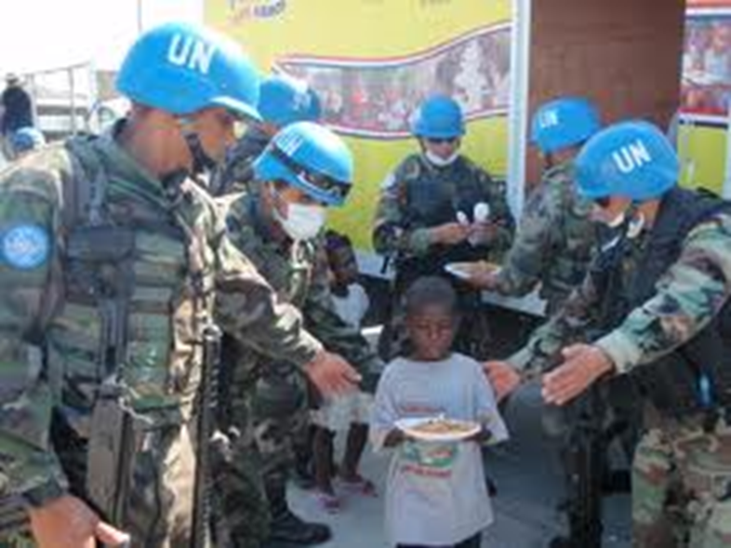

Slide 8
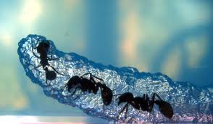

Slide 9
Group Pressure
How will you respond to group pressure?
Develop your skills…

Slide 10
Dealing with Group Pressure
1. Listen to what others want you to do.
2. Think about what might happen.
3. Decide what you want to do.
4. If you decide not to go along with the group,
say to them, “No, I can’t because_______
(give the reason)”.
5. Suggest something else to do.

Slide 11
Model Role Play…

Slide 12
Dealing with Group Pressure
1. Listen to what others want you to do.
2. Think about what might happen.
3. Decide what you want to do.
4. If you decide not to go along with the group,
say to them, “No, I can’t because_______
(give the reason)”.
5. Suggest something else to do.

Slide 13
Current Issues?
Students share examples of group pressure

Slide 14
Interactive Role Plays…
Student Groups
Refer to the steps!

Slide 15
Dealing with Group Pressure
1. Listen to what others want you to do.
2. Think about what might happen.
3. Decide what you want to do.
4. If you decide not to go along with the group,
say to them, “No, I can’t because_______
(give the reason)”.
5. Suggest something else to do.

Slide 16
Performance Feedback:
Co-actors?...

Slide 17
Performance Feedback:
Co-actors?...
Observers?...

Slide 18
Performance Feedback:
Co-actors?...
Observers?...
Trainers?...

Slide 19
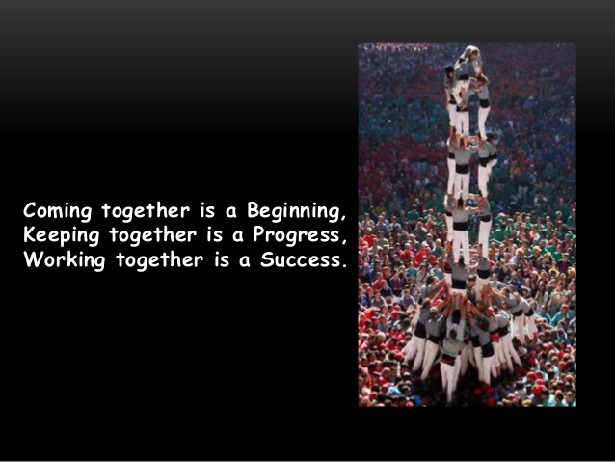
Your Challenge…

Slide 20
References
Albrecht, S. START,Plus, PowerPoint, 2012.
Goldstein, A., McGinnis, E., 1997. Skillstreaming the elementary school child: New strategies and perspectives for teaching prosocial skills, Research Press.
http://www.slideshare.net/ShwetaSharma72/teamwork-18900459?from_search=6
http://www.haitiquake-archive.unlb.org/Picture%20Library/Forms/DispForm.aspx?ID=193
http://www.hiroshima-remembered.com/history/nagasaki/image3.html
http://www.telegraph.co.uk/news/worldnews/europe/france/4641117/France-responsible-for-holocaust-deportations-court-rules.html

Slide 21
References continued…
https://community.republicwireless.com/unsupported-browser.jspa
http://www.autismafter16.com/article/11-28-2012/anti-bullying-strategies
http://ideonexus.com/tag/toys/
http://www.dailymail.co.uk/news/article-2225933/Hurricane-Sandy-Hundreds-pet-owners-frantically-look-lost-loved-ones.html

