Slide 1
Improving Communication Skills Improves Achievement: A Prevention Program
Samantha Fitzjarrald

Slide 2
Mission Statement
The mission of Muncie Community Schools is to provide a quality educational environment that allows every student to maximize his or her potential and upon graduation, possess the basic skills necessary to be a positive, productive, contributing member of society.

Slide 3
Beliefs & Philosophy
We agree that communication skills are essential to the academic achievement of students.
We agree that different types of skills (interpersonal, intrapersonal, nonverbal, & active listening) need to be understood for the best chance of improving academic achievement.
We agree that a basic understanding of these will help the relationship between students and their teachers/classmates.
Our overall goal is for this program to improve the grades of the students and their testing results. That will show that this program is a success.

Slide 4
Interpersonal Communication Skills Research
Children should be able to demonstrate well-developed interpersonal skills by ages 5-6.
Different language domains play different roles in interpersonal communication skills, which leads to different types of achievement.
Higher interpersonal communication skills lead to higher development of language, which leads to higher achievement.
Sugishita, S., Fukushima, K., Kasai, N., Konishi, T., Omori, K., Taguchi, & T., Fugiyoshi, T. O. (2012). Language development, interpersonal communication, and academic achievement among Japanese children as assessed by the ALADJIN. Annals of Otology, Rhinology, & Laryngology, 121, 35-39.

Slide 5
Interpersonal Communication Skills Research 2
Interpersonal skills are essential for communicating, discussing, and exchanging ideas effectively with teachers and peers.
Without these the students often struggle with the learning process as a whole.
14.4% of students are at a high level of interpersonal skills, 85% at a moderate level, and .6% are at a low level. The low level would be the focus of most interest and action.
Interpersonal Skills do not affect self-concept, but do affect achievement.
Yahaya, A. & Ramli, J. (2009). The relationship between self-concept and communication skills towards academic achievement among secondary school students in Johor Bahru. International Journal of Psychology Studies, 1, 25-34.

Slide 6
Social-Communication Skills
Young students, as early as head starts, need to understand social-communication skills & how to interact with other students to achieve.
Interventions could include role-playing in social situations with play scenarios to increase their social-communication skills.
Important to understand the importance of establishing eye contact, initiating, maintaining a joint topic of conversation, turn-taking, & being responsive.
“Children with social-communicative skill deficits are subject to academic & behavioral difficulties, & may be more likely to experience a variety of poor adult outcomes, including antisocial behavior & serious psychiatric disturbances.”
Craig-Unkefer, L. A. & Kaiser, A. P. (2003). Increasing peer-directed social-communication skills of children enrolled in head start. Journal of Early Intervention, 25, 229-247.

Slide 7
ASCA National Standards
Domains: Academic, Personal/Social
A:A1.5 identify attitudes and behaviors that lead to successful learning
A:A2.3 use communication skills to know when and how to ask for help when needed
A:A3.2 demonstrate the ability to work independently, as well as the ability to work cooperatively with other students
PS:A2.6 use effective communication skills
PS:A2.7 know that communication involves speaking, listening, and nonverbal behavior

Slide 8
Guidance Curriculum
Interpersonal Communication
Intrapersonal Communication
Nonverbal Communication
Active Listening

Slide 9
Management System
Students will continue to be monitored by their teachers. Teachers will refer students to the after-school group as necessary.
School counselor will do a lesson over these skills each quarter to make sure students are improving & retaining information.
Use immediate data from pre/post tests & student rubrics. Long-term results can be taken from test scores and grades.

Slide 10
Small Group
Students who do poorly on the post-tests and are referred by their teachers will be put into a small after-school group.
Ten students
Eight sessions
45 minutes long
They will work extensively on their communication skills through lecture, role-play, discussion, and other activities.

Slide 11
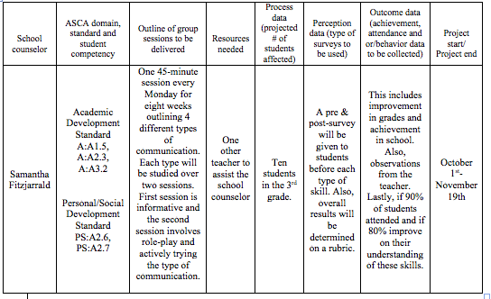
Action Plan

Slide 12
Accountability
Student Rubric
Pre/Post Test Example
Participation __/8
Completed Pre/Post Surveys __/20
Completed Written Reflection from Intrapersonal __/2
Completed Classroom Activities/Worksheets __/20
Final Grade __/50
I understand the difference between interpersonal and intrapersonal communication skills.
Yes No
I feel that I communicate well with other students.
Yes No
I feel that I communicate well with my teachers.
Yes No
I can listen to others as they speak without interrupting them.
Yes No
I know how to work well in a group working towards a common goal.
Yes No

Slide 13
References
American School Counselor Association (2012). The ASCA National Model: A Framework for School Counseling Programs, Third Edition. Alexandria, VA: Author.
Craig-Unkefer, L. A. & Kaiser, A. P. (2003). Increasing peer-directed social-communication skills of children enrolled in head start. Journal of Early Intervention, 25, 229-247.
Sugishita, S., Fukushima, K., Kasai, N., Konishi, T., Omori, K., Taguchi, & T., Fugiyoshi, T. O. (2012). Language development, interpersonal communication, and academic achievement among Japanese children as assessed by the ALADJIN. Annals of Otology, Rhinology, & Laryngology, 121, 35-39.
Wittmer, J., Thompson, D. W., & Loesch, L. C. (1997). Classroom guidance activities: A sourcebook for elementary school counselor. Minneapolis, MN: Educational Media Corporation.
Yahaya, A. & Ramli, J. (2009). The relationship between self-concept and communication skills towards academic achievement among secondary school students in Johor Bahru. International Journal of Psychology Studies, 1, 25-34.

