Slide 1
Using Social Media as a Resource
Samantha Fitzjarrald

Slide 2
What is Social Media?
Social media is, “a group of Internet-based applications that build on the ideological and technological foundations of Web 2.0 and that allow the creation and exchange of User Generated Content” (Kaplan & Haenlein, 2010).
Web 2.0 was the movement where users could all be collaborative partners on any platform
In other words, social media means a place where people can share their thoughts and work together on content instead of working on an individual application.

Slide 3
Types of Social Media
Facebook
Twitter
Tumblr
Pinterest
LinkedIn
Google+
YouTube
Instagram
Voxer
Vine
Keek
Skype
MySpace
Personal Blogs

Slide 4
Advantages of Using Social Media
Collaborative Projects
Educational/Informative Blogs
Connecting with colleagues from other areas of the state/country
Recycling resources!!!!!
Getting new laws or the latest legislature at a quicker rate
Interacting with all types of educators

Slide 5
Disadvantages of Social Media
Often involves a lot of self-disclosure
Ethical challenges when the students start trying to connect via social media
Using websites like Wikipedia might not be factual or evidence-based
Lack of privacy

Slide 6
Using Twitter Specifically

Slide 7
Twitter: Why should we Tweet?
“There are some jewels herein that can lead to stimulating discussions, new resources, and an ongoing supportive network. You just have to know where to look.”
Betty Ray (Edutopia)

Slide 8
Twitter
How do I use Twitter?
See handout
How do I create a username?
How can I add other school counselors?

Slide 9
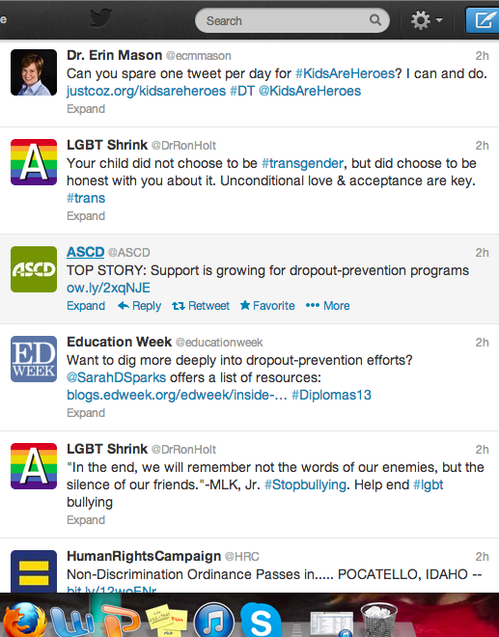
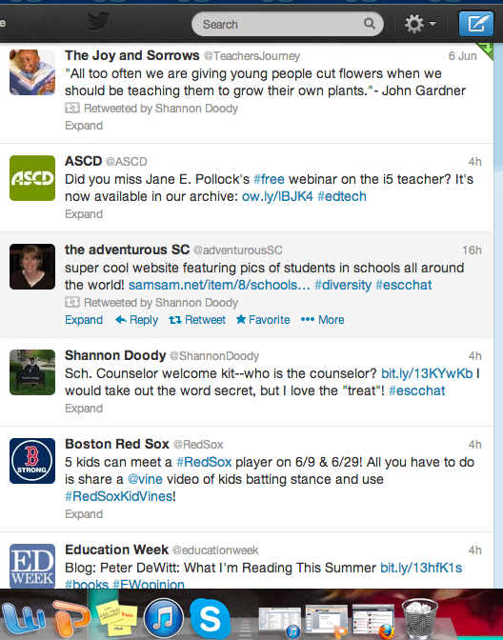
Examples of Tweets

Slide 10
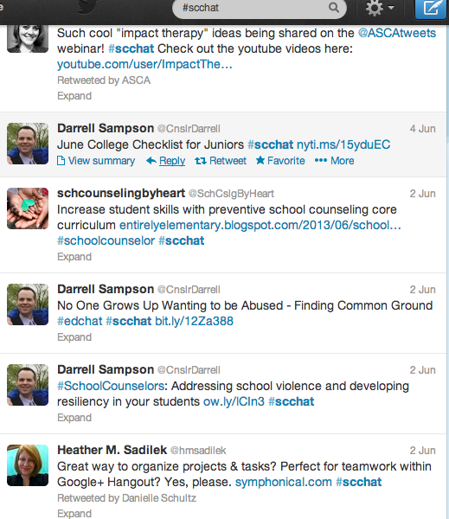
#scchat
There are weekly chats where counselors get together and answer questions on how they would handle specific situations or where they can get certain resources. To join these one must just add #scchat to their tweets when answering. People add resources throughout the week to help people as well (as shown in the picture).

Slide 11
Some of the Resources I’ve Found
http://musiccityschoolcounselor.wordpress.com/category/who-is-the-counselor/
http://jyjoynercounselor.blogspot.com/2013/05/tips-for-new-school-counselor-graduates.html?utm_source=feedburner&utm_medium=twitter&utm_campaign=Feed%3A+Jyjoynercounselor+%28jyjoynercounselor%29
https://sites.google.com/site/schoolcounselingconnection/
http://www.schoolcounselorresource.com/

Slide 12
References
Kaplan, A. M. & Haenlein, M. (2010). Users of the world, unite! The challenges and opportunities of social media. Business Horizons, 53, 59-68.

